Slide 1
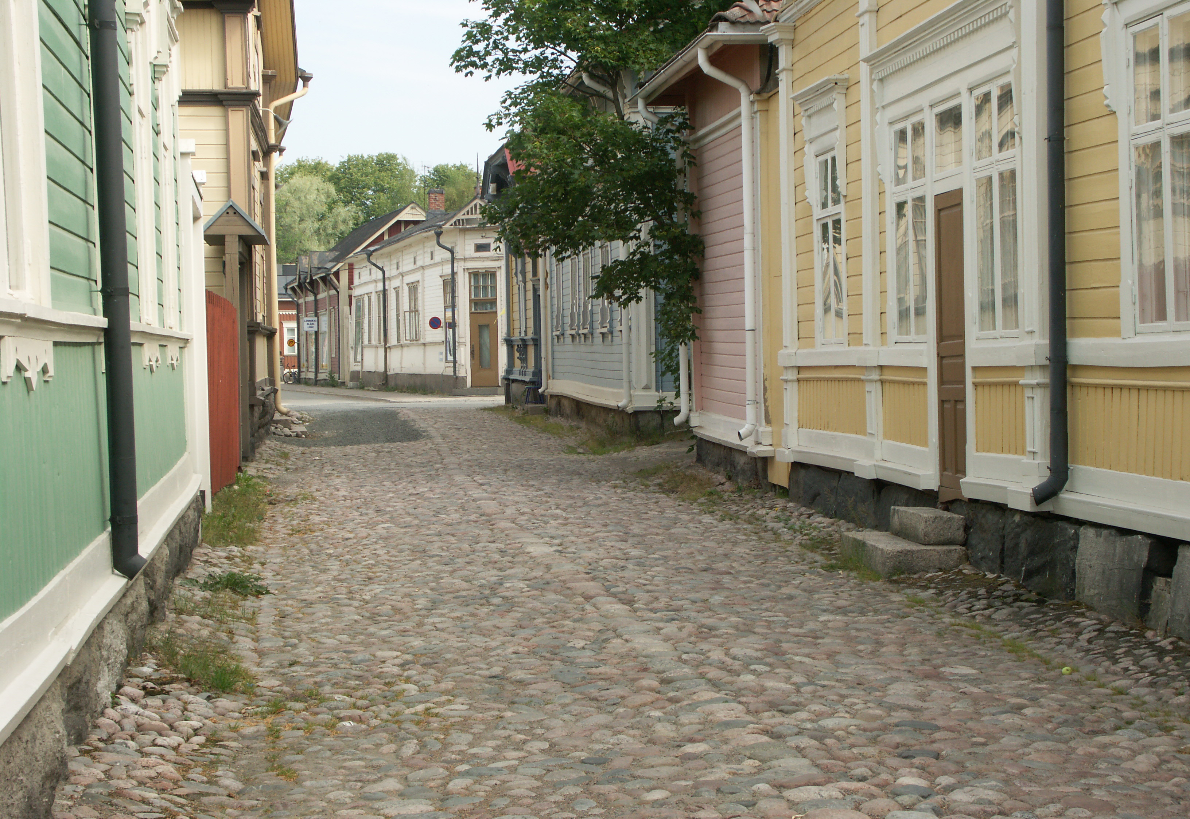
Using MarvelApp
Prepared by G Khan

Slide 2
What is Marvel App?
The Marvel App is
an app that allows you to design and create prototypes of your own apps.
free.
a collaborative design platform where you can create a wireframe, prototype, user test, design and inspect designs or create an integration
all in one place
https://marvelapp.com/

Slide 3
An Example
Requirements for a UNESCO WH project for a Visitor Centre which should offer education, promotional and other services
at that time there wasn’t a visitor centre in Old Rauma
nor is there a single physical space where this information is available despite there being multiple museums in the town
Similarly, the website doesn’t provide such details
Other factors constraining access include:- distance (must be reached by car/bus), no access for disabled visitors, winter weather, no available big space

Slide 4
Resources available at the Centre
Some space
Several Artefacts including
Models
Games
Maps
Vintage recordings and transcripts of stories of living locals
Events – Lace Week, occasional sports matches

Slide 5
The Concept
To create an application which links the artefacts with buildings, stories and locals
Through a mixed reality experience visitors will be able to enter the homes virtually and meet the locals, listen to the true stories, photos and audio recordings of the inhabitants of these buildings.
These will be recorded by the locals themselves.
The stories would connect buildings, pictures, audio and people and direct visitors to other places connected to that people where they would enjoy the actual surrounding.
This experience could also happen in reverse where visitors first visit a building then become immersed in the history at the Renovation Centre

Slide 6
The Concept cont.
To use the existing materials
Including local participation and
Creating links to other places and events of interest within the town

Slide 7
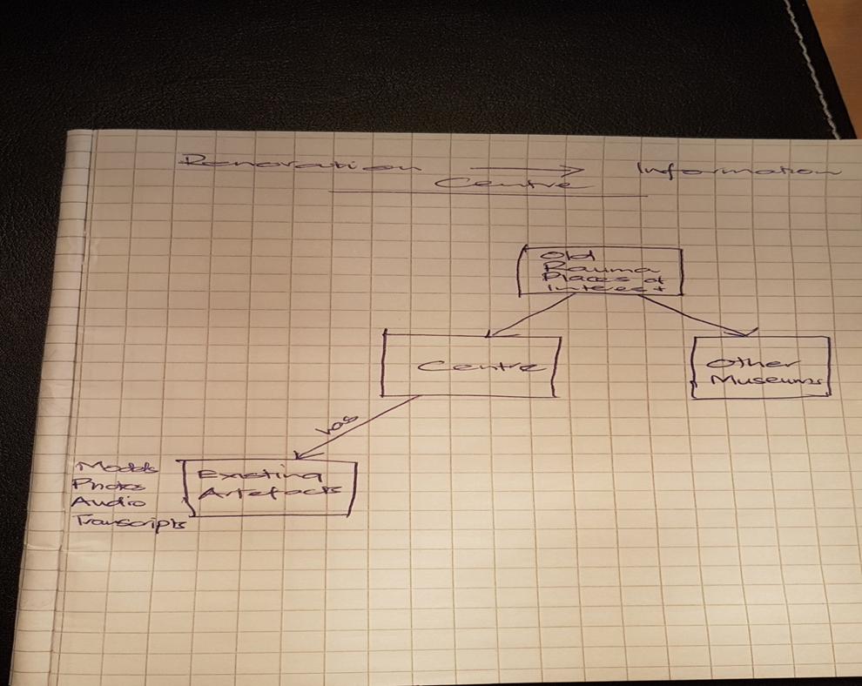
Starting point for the design

Slide 8
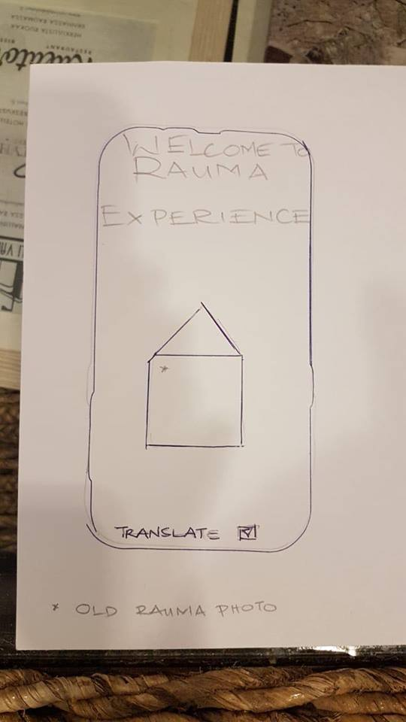
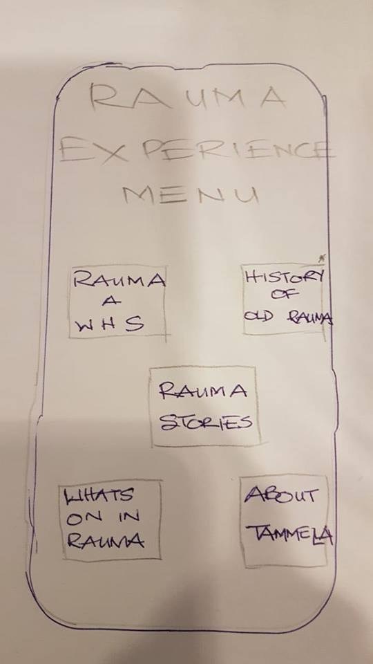
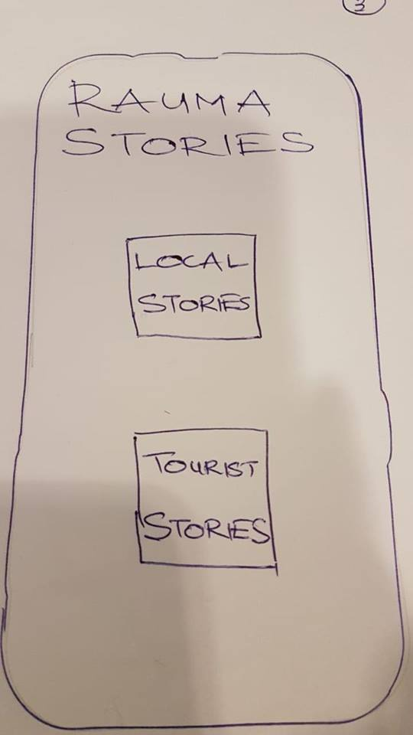
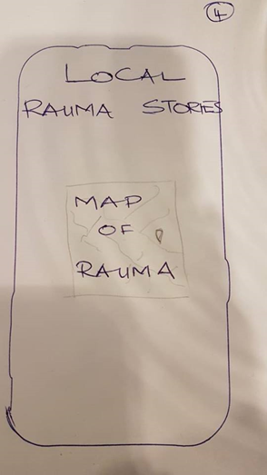
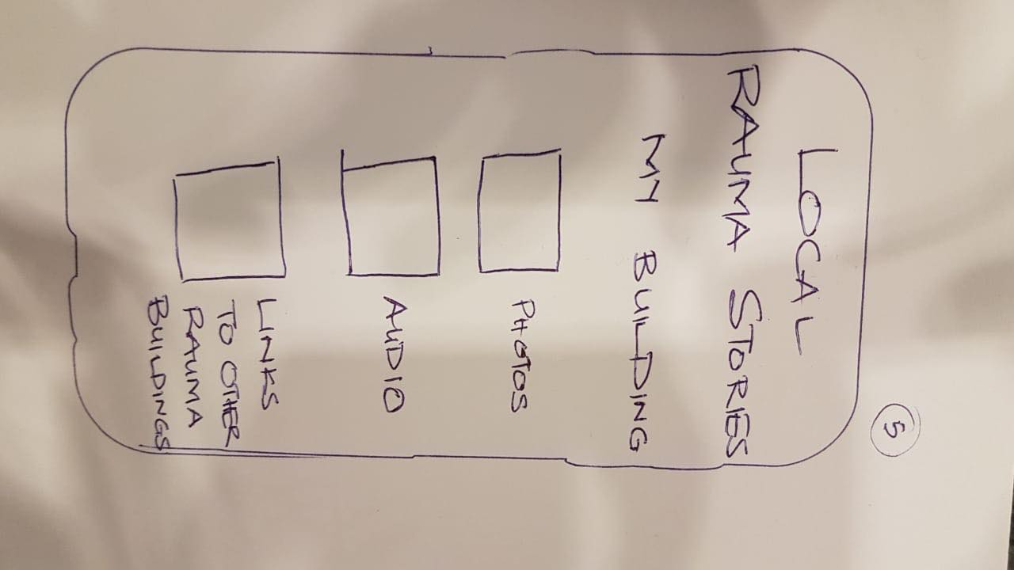
The Static Design Wireframe

Slide 9
The Dynamic Design Wireframe
To build the concept
drew sketches of the application,
uploaded them on the https://marvelapp.com/
where we created an dynamic wireframe for the application.

